Slide 1
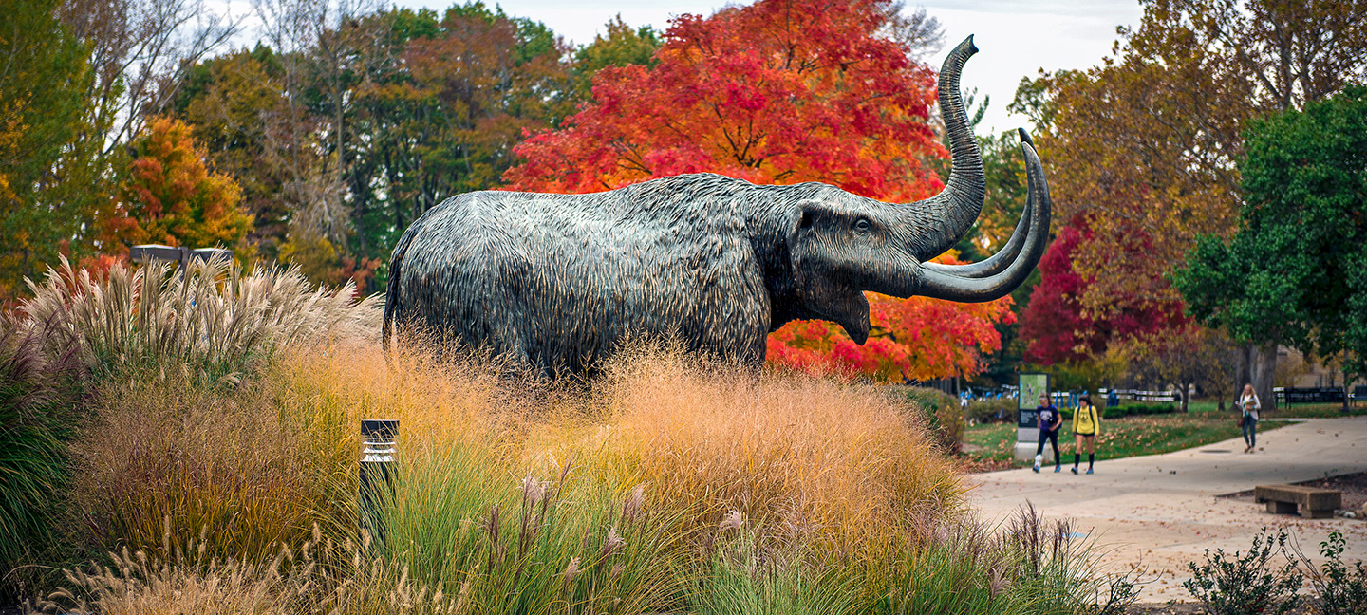
Student Research & Creative Endeavor Symposium Developing a good poster
Dean Emerita Cheryl Truesdell, Helmke Library

Slide 2
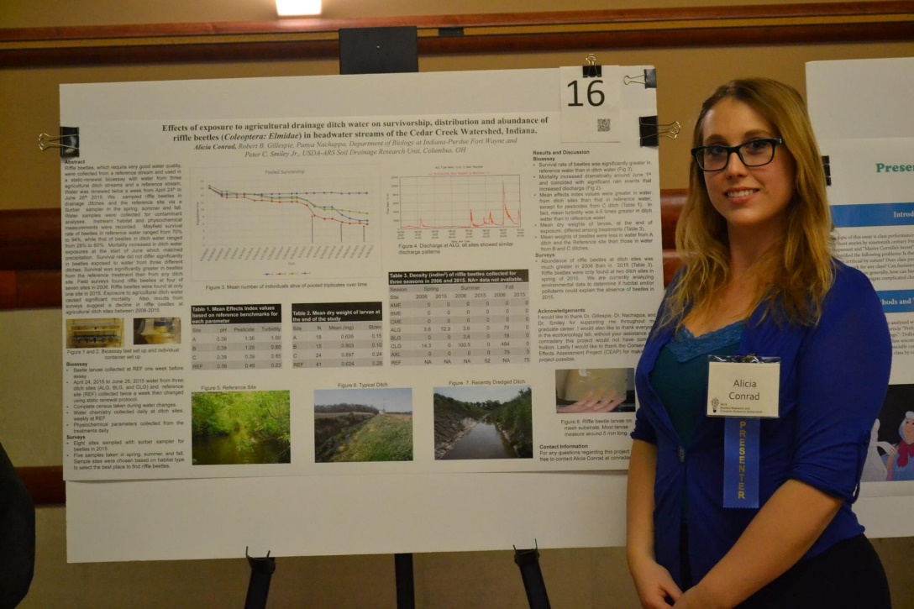
Parts of the poster
Disciplines have different methods of presenting information
Include sections that are relevant to your project
Consult your faculty mentor in determining the poster contents

Slide 3
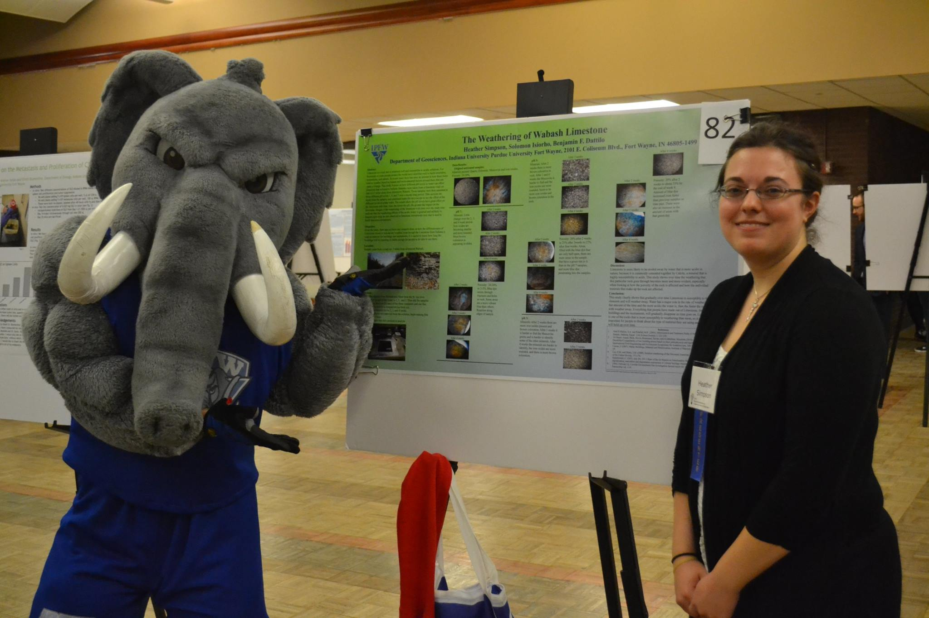
Most common parts
Of the poster
Title
Abstract
Methods
Results
Conclusion
Literature Cited
Acknowledgements

Slide 4
Title
Should contain the keywords of the project
First text observers will read
Primary search field for online discovery
Sample: Do Nonprofit Nursing Homes Perform Better Than For-Profit Nursing Homes? Empirical Evidence in Indiana
Sample: Puerarin: from the roots of kudzu, an invasive plant, to the front lines in modulating stress within farmed salmonids.

Slide 5
Abstract
Briefly outlines research/creative project
Clear, concise, precise wording
Informative, descriptive, compelling

Slide 6
Introduction
What are the reasons behind this project?
What did you set out to do?
What were the study’s hypotheses or questions?
Why it is important?

Slide 7
Methods
Methodology
What did you do?
What techniques did you use?

Slide 8
Results
How was the data analyzed?
What did you find?
What does your data mean in the real world?

Slide 9
Conclusion
What conclusions did you draw from the analysis?
Is additional work needed?
What are the implications?
What are the future directions?

Slide 10
Literature Cited
List significant sources consulted
You may put them here or any place you feel comfortable putting them on the poster.

Slide 11
Acknowledgement
Acknowledge any partner(s) or funding/resources support

Slide 12
Examples
Student Research and Creative Endeavor Symposium Posters are available online at: PFW Student Works

